Slide 1

INTERNATIONAL INSTITUTE OF INFORMATION TECHNOLOGY
Object Oriented Programming using C++
Project
REAL ESTATE FILE MANAGEMENT SYSTEM
Group 6
Ritesh Mahato(B215023)
Susri Samal(B215038)
Rohan Sahoo(B215045)
Bitaan Chakrabarti(B215019)

Slide 2
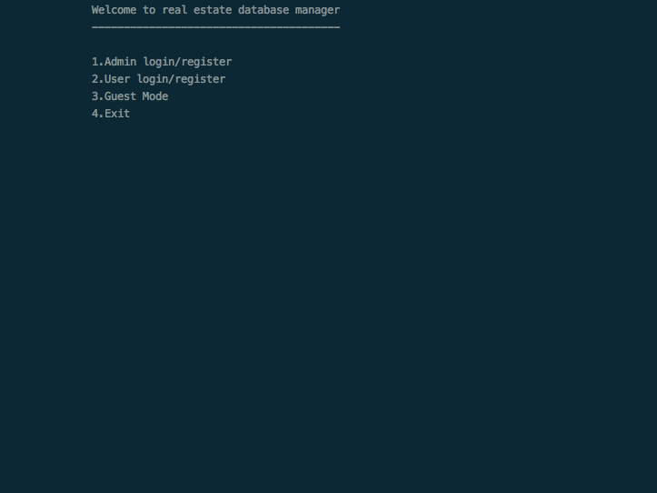
HOME PAGE
Here, we have options of:
1.Admin login/register
2.User login/register
3.Guest mode
4.Exit
According to our choice.
The menu functions are executed and our entered choice will call functions of the admin, user or guest classes.

Slide 3

GUEST MENU
Here, the guest class functions will be executed, depending on your choice.
Search:it will call the getData(),getRecords() and countRecords() & countParameters() functions to fetch the files that need to be shown to the guest as per our entered parameter choices.

Slide 4

The minimal() function will prevent the guest from gaining too much information,and display only essential features.

Slide 5
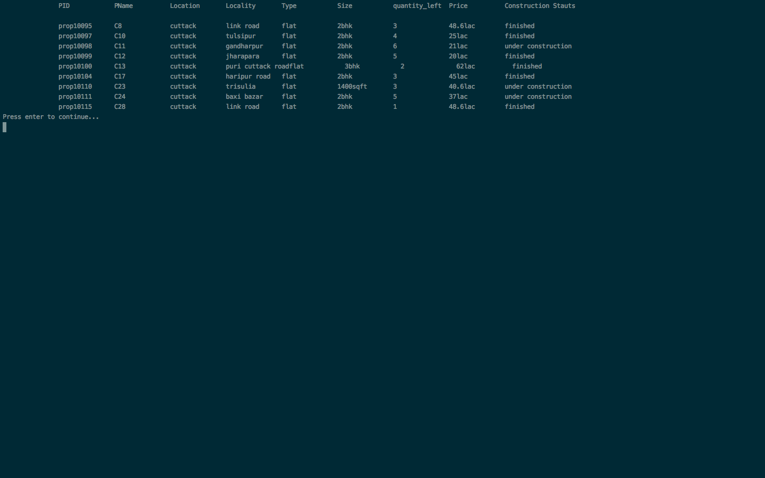
Output given according to input.

Slide 6

USER MENU
Here, the user functions shall be executed. There are the standard register() & login() functions and additionally the forgotPassword() function.

Slide 7

NEW USER(LOGIN)
The login() of the user class takes user-id,username,password & creates a new user CSV file with create().

Slide 8

USER LOGGED-IN
We have 7 options:
1.Will call get data(),get records() & CSVProcessor()
2.Will call my properties()
3.Will call registered properties
4.Will update profile()
6.Check Registration status()

Slide 9
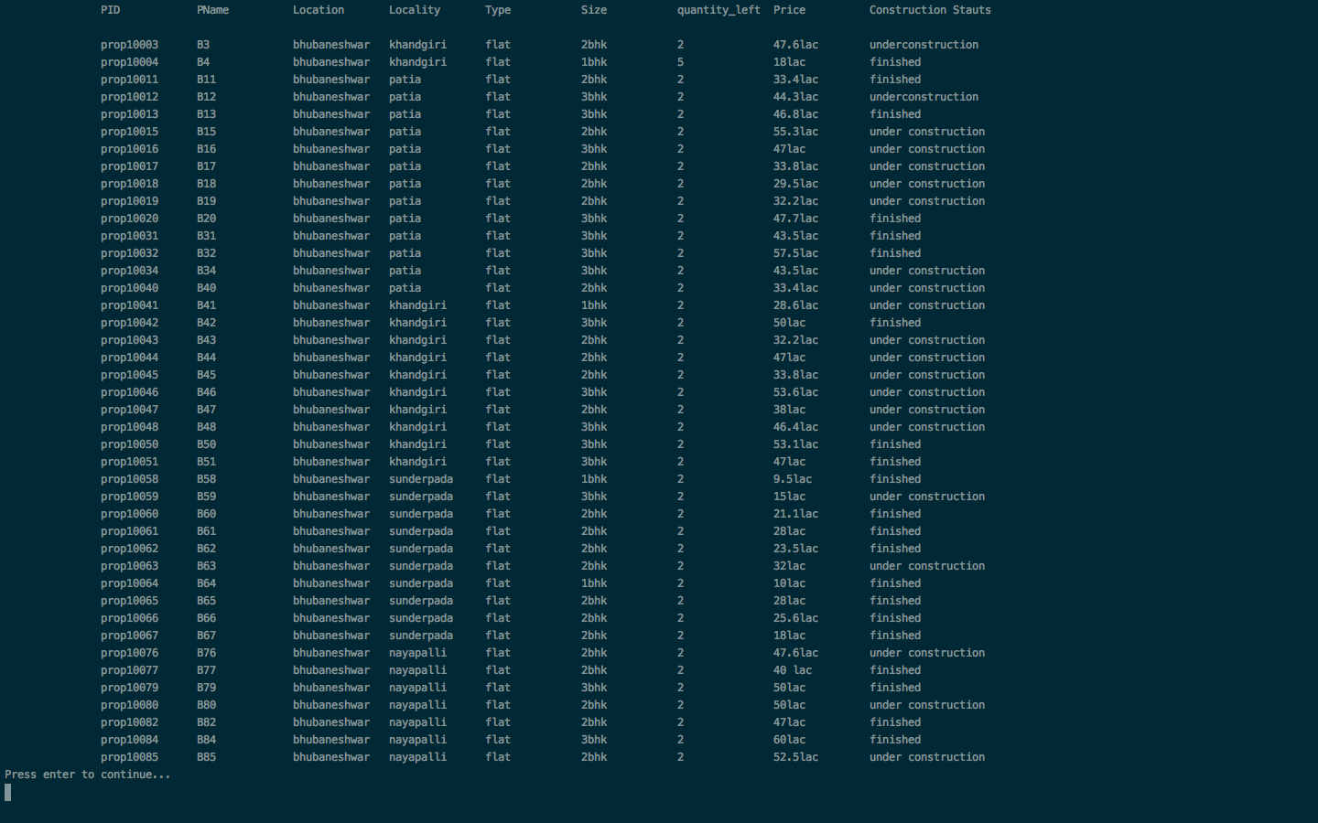
OUTPUT FILE
Output all the values that match the entered parameters. The match occurs based on the compare() function.

Slide 10
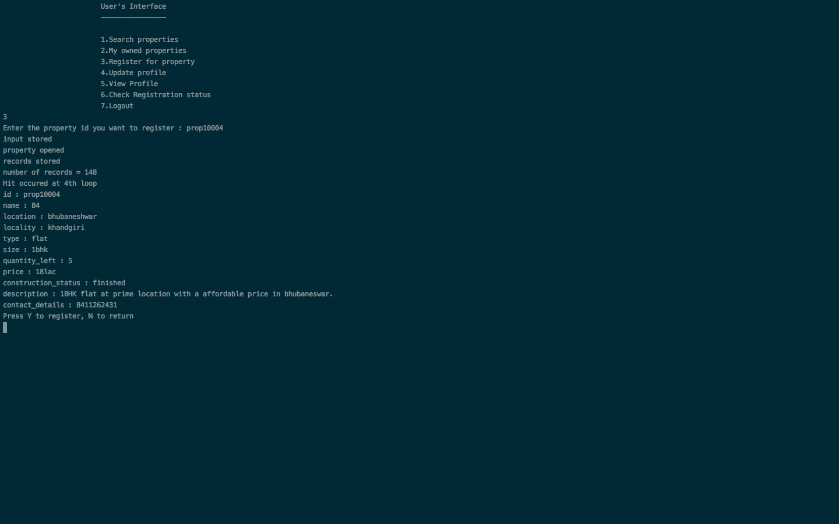
PROPERTY REGISTER
Property register() function invoked and the user may register a new property,with details and also the update value() & update the records in the CSV.

Slide 11
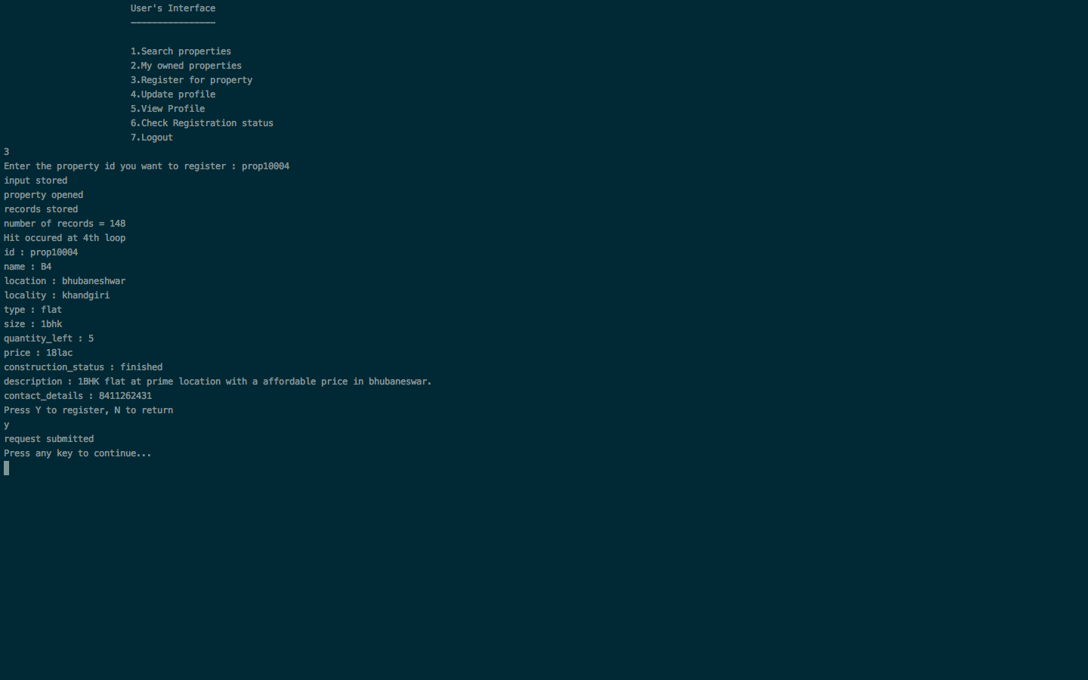

Slide 12


Slide 13


Slide 14

ADMIN MENU
Options that lead to different admin class functions being invoked.

Slide 15

LOGIN
A unique admin-id,name & password has to be entered to login.

Slide 16
LOGGED IN
This page contains the following: 1.Search()
2.Add property()
3.Delete property()
4.Pending()

Slide 17


Slide 18


Slide 19


Slide 20


Slide 21
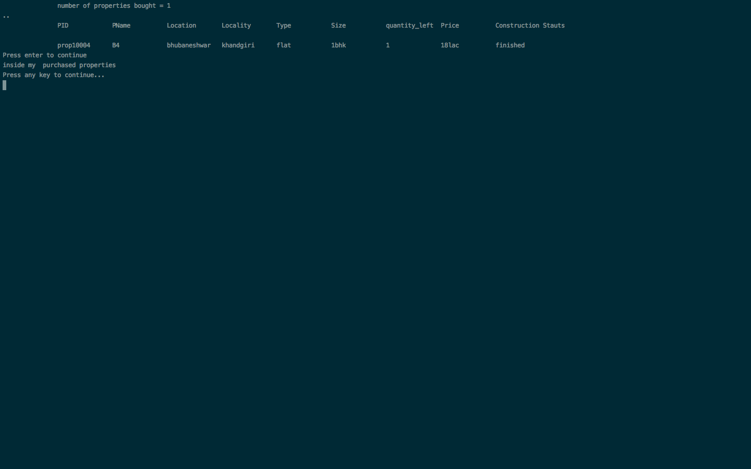

Slide 22


Slide 23
MAIN OOP FEATURES USED IN OUR PROJECT
DATA ABSTRACTION AND ENCAPSULATION:
These are features that have been used throughout our project. We have used it in the various classes that we have used.
INHERITANCE:
This is one of the main features used in the project. We have used inheritance for every functionality. getData(), countAttributes(), checkReg() and so on.
ERROR HANDLING:
This is a feature we have used in the CSVProcessor() to make sure our code can handle errors properly, in the way we want it to be handled.
NAMESPACE:
We have used it while defining the namespace std and integerString but haven’t extensively used it.
FILE HANDLING:
This is the most obvious feature ised, because file-handling has been used for reading and writing to the CSV and for updation and deletion and what not.

